Slide 2
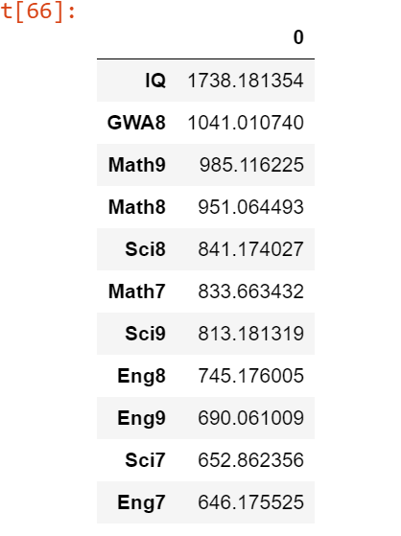
Features from CHI2 with original data

Slide 3
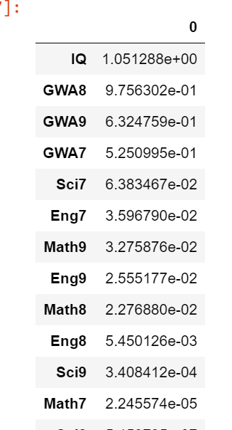
Features from CHI2 with normalized data

Slide 4
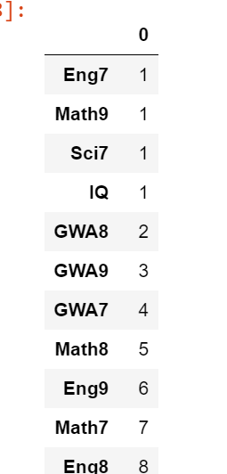
Features using RFE with normalized values

Slide 5
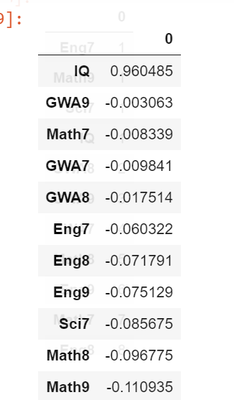
Features using PCA with normalized values

Slide 6
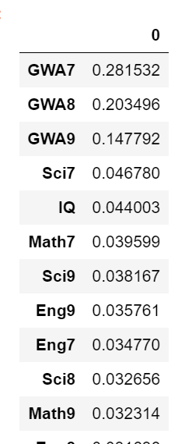
Feature Importance with Extra Trees Classifier USING normalized values

Slide 7
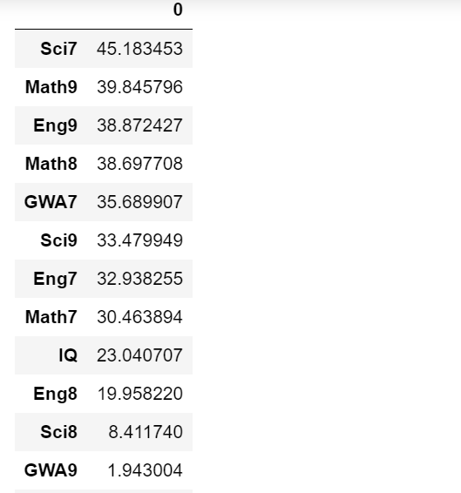
Features from CHI2 with rescaled data (MinMaxScaler)

Slide 8
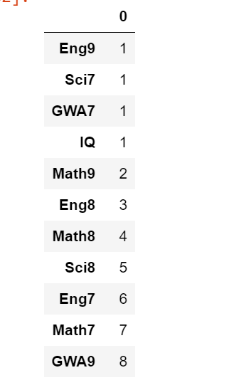
Features using RFE with rescaled values (MinMaxScaler)

Slide 9
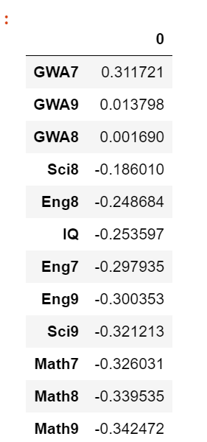
Features using PCA with rescaled data

Slide 10
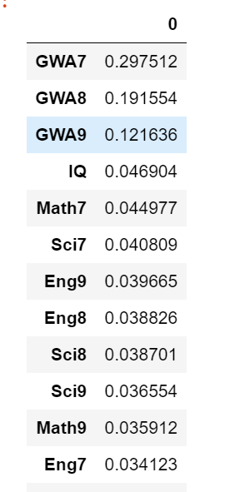
Feature Importance with Extra Trees Classifier USING rescaled values

Slide 11
DATA MODELING

Slide 12
Using Train_test Logistic Regression
Original data
87.349%
Normalized data
60.54%

Slide 13
Data modeling
 | Original data | normalized
Test_train Logistic Reg | 87.349% | 60.542%
Cross validation | Accuracy: 86.189% (4.058%) | Accuracy: 60.042% (6.909%)
Leaveoneout cross validation | Accuracy: 86.382% (34.298%) | Accuracy: 61.730% (48.605%)

Slide 14
Using diff algo modeling with orig dataset (Mean accuracy after k-fold) | With normalizer (in pipeline) | Using normalizer, PCA, LR w/ k-fold | Using origdata, PCA, LR w/ k-fold
LR: 0.861891 (0.040579) LDA: 0.865881 (0.043194) KNN: 0.831059 (0.047611) CART: 0.796178 (0.027143) NB: 0.833960 (0.036373) SVM: 0.524960 (0.072022) | LDA w/normalizer - 0.8509405940594059 LDA w/ StandardScaler - 0.865881188118812 | 0.8698217821782178 | 0.8668217821782178

Slide 15
 | LR | LDA | KNN | CART | NB | SVM
Normalizer, PCA | 0.8698217821782178 | 0.8609009900990099 | 0.837990099009901 | 0.8111287128712872 | 0.8170000000000002 | 0.688039603960396
Standardscaler, PCA | 0.8638811881188119 | 0.865881188118812 |  |  |  | 0.688029702970297

